Slide 1
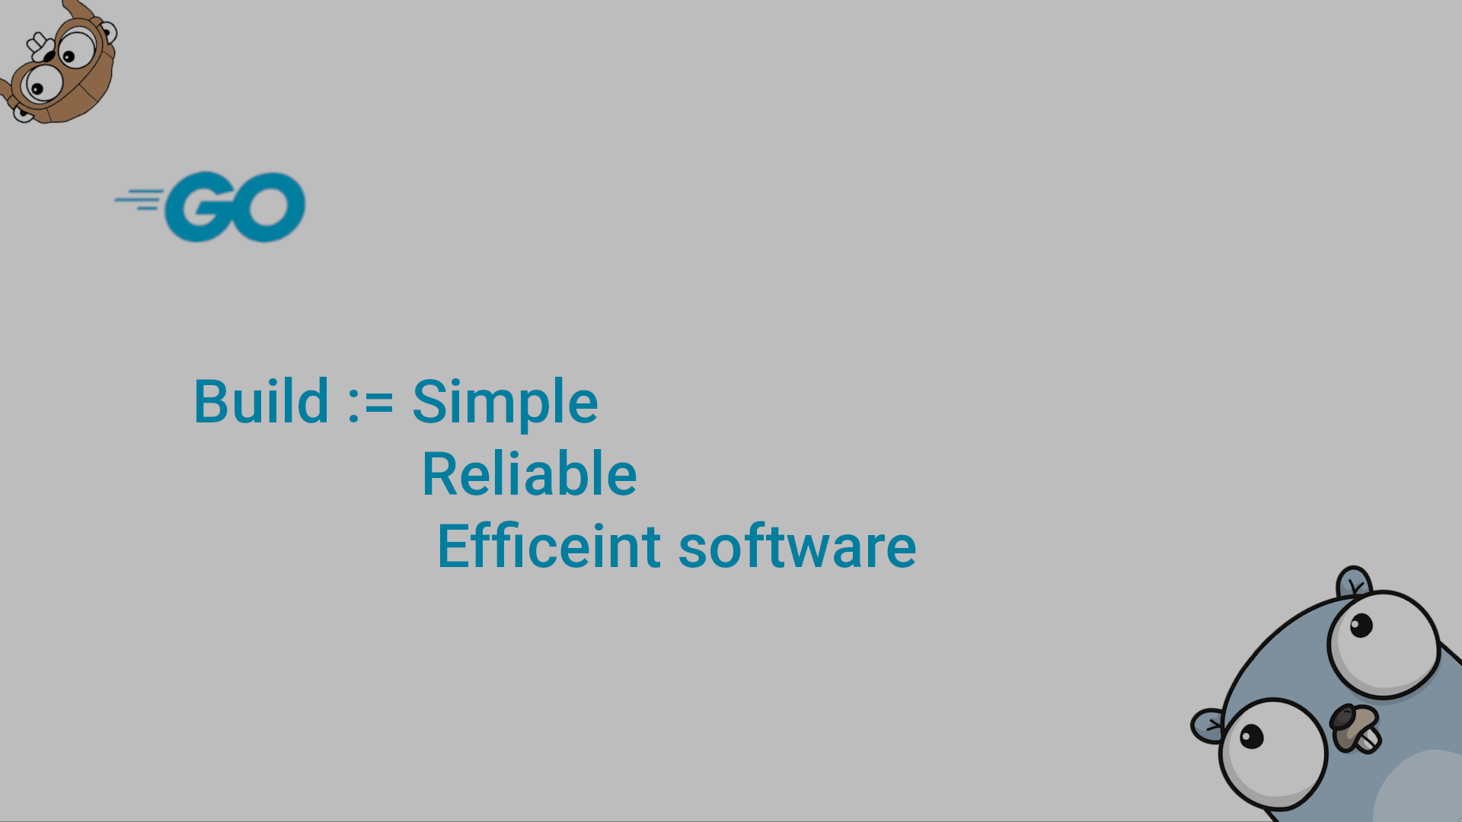
Go through the Network
The HTTP & the way to optimal parallelization

Slide 2
Suppose that we have a bunch of files that we need to process; how can we think about this?
At first, we assign a goroutine for each file, and then with the help of the master thread, we can synchronize these routines to match our desired output. But what is the optimal number of threads to assign without hurting the performance?!!
Secondly, in the same way, we can make a process for each file or (bunch of files?), then we synchronize again. But if we make use of the property that each process can run multiple threads, will this cause problems with the actual distributed architecture of the CPU (NUMA) and the abstract view of the OS to the CPU?

Slide 3
The Concurrent Solution (The View):
Active Threads
Their number is specified by the OS, and they give the program the parallelism property
core1
core2
core1
core2
core1
core2
Interconnect
Interconnect
Interconnect
Interconnect
Memory
Memory
Memory
Memory

Slide 4


The Concurrent Solution (The Way):
Our Data
First, we create a call stack (goroutine) to handle one file
Second, we assign each file to its corresponding stack
Each of the stacks will do the same function
Finally, with the help of channels, we can map the results of each stack to the master thread to formulate the output
Master

Slide 5
The Parallel Solution (Analysis):
To start a process means to run an independent program. One way to think for this that we can make a Go file that does our logic then run it multiple times from the cmd.
Of course we don’t need to do it manually, so like the concept of the master thread we make a master process that start other processes.
How to start: first build your code that do the logic, then make it a command line tool that take a number of positional and optionall arguments.
Once you have your code ready you then make the other Go master file that will run the other processes and pass the arguments to it.
Now we have processes, so we can synchronize the communication among them.
But we will end up in something unpredictable; what is really going on, we don’t know. One more note: we didn’t expose the original view of the CPU architecture yet.

Slide 6
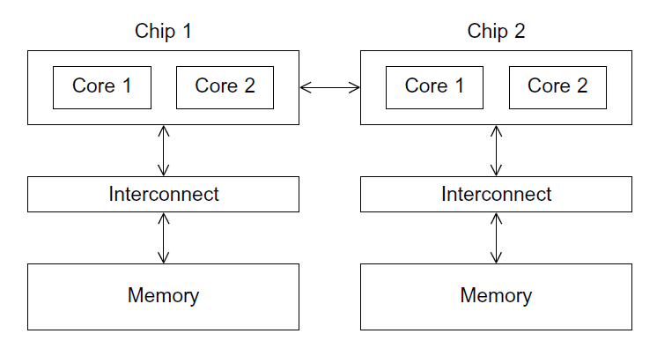
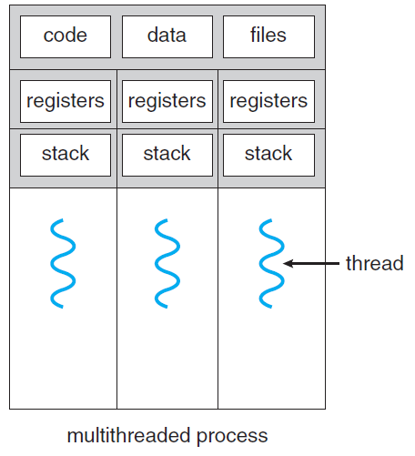
The Parallel Solution (Exposing the NUMA):

Slide 7
The Parallel Solution (Exposing the NUMA):
Now we have these processes running simultaneously; in other words, the processes are parallel
Since we have running instances, we need communication, so we need something shared at this time; it will be the network, not RAM
Do we get rid of cache coherence? And how will we make use of the genuine channels? Finally, will the goroutines have a role in our program
Two main parts will guide our design: the HTTP request and how the data transfers through the network (JSON)
Since our apps communicate through the network, we are doing network/web programming.

Slide 8
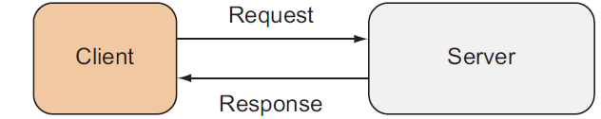
Go Web Programming:
A web application is a computer program that responds to an HTTP request by a client and sends back to the client in an HTTP response.
Microservice
Microservice
The URI is an umbrella term that includes both the URN and the URI, and they have similar syntax and format
HTTP
Only the scheme name and the hierarchical parts are mandatory. The query, which starts with a question mark (?), is optional and contains other information that’s not hierarchical in nature.
To end this part, we will think of each process as a microservice/webservice that accepts an HTTP request and send responds. So, each service will be a running server instance that we can call through a request.

Slide 9
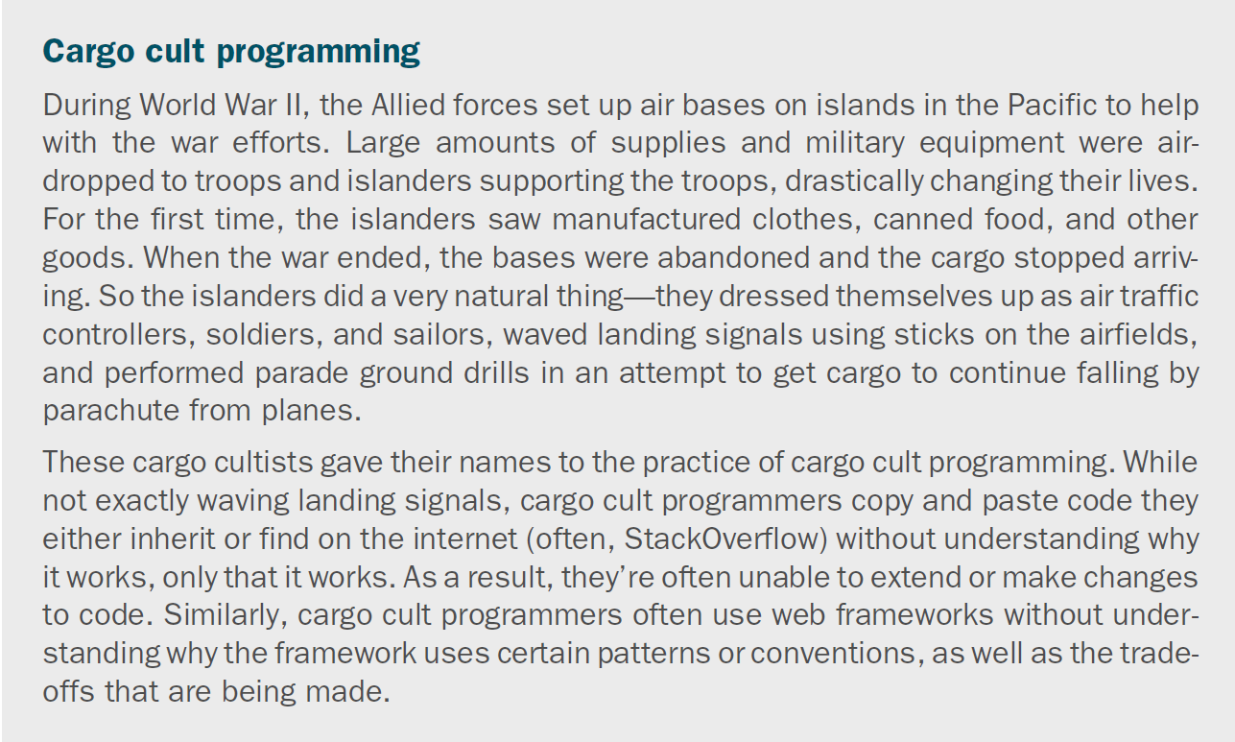

Slide 10
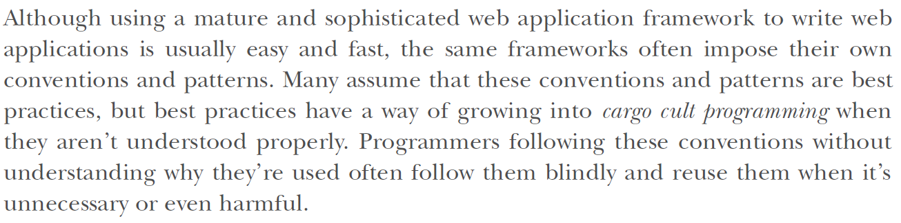

Slide 11
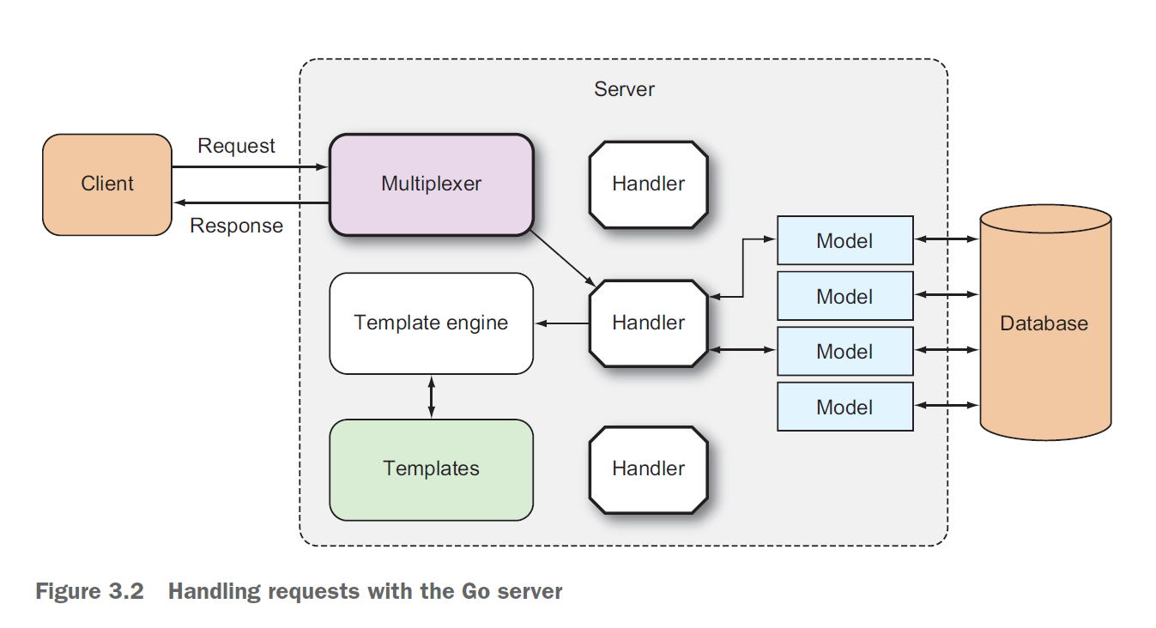
Serving Go:
The net/http library provides capabilities for starting up an HTTP server that handles requests and sends responses to those requests. It also provides an interface for a multiplexer and a default multiplexer.

Slide 12
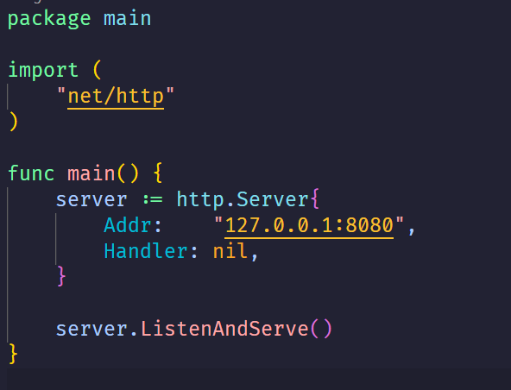
The Go web server:
Creating a server is trivial and can be done with a call to ListenAndServe, with the network address as the first parameter and the handler that takes care of the requests the second parameter

Slide 13
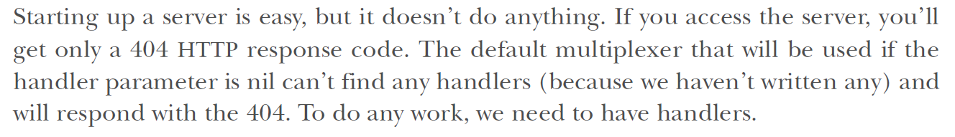
Handlers and handler functions:
A handler is an interface that has a method named ServeHTTP with two parameters: an HTTPResponseWriter interface and a pointer to a Request struct.
In other words, anything that has a method called ServeHTTP with this method signature is a handler:

Slide 14
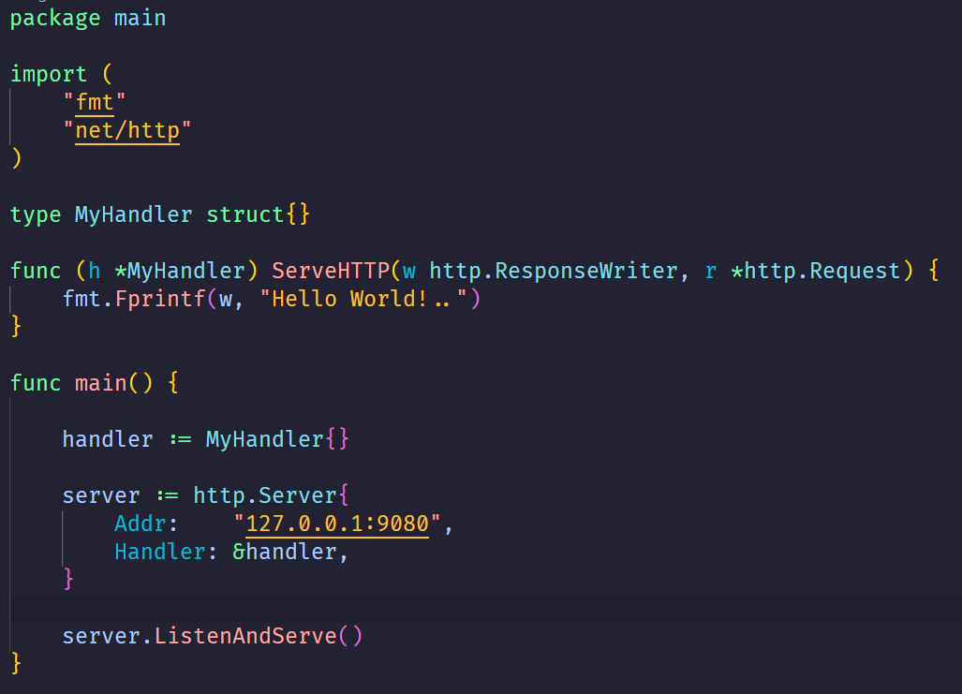

Handling request:
This is called a handler/endpoint/route/action
The function associated with any handler that defines the logic of the response, given the two main parameters, the Request and ResponseWriter
If you go to http://localhost:9080 in your browser, you’ll see Hello World!
Here’s the tricky bit: if you go to http://localhost:8080/anything/at/all you’ll still get the same response! Why this is so should be quite obvious. We just created a handler and attached it to our server
There’s no longer any URL matching to route the request to a particular handler; all requests going into the server will go to this handler.

Slide 15
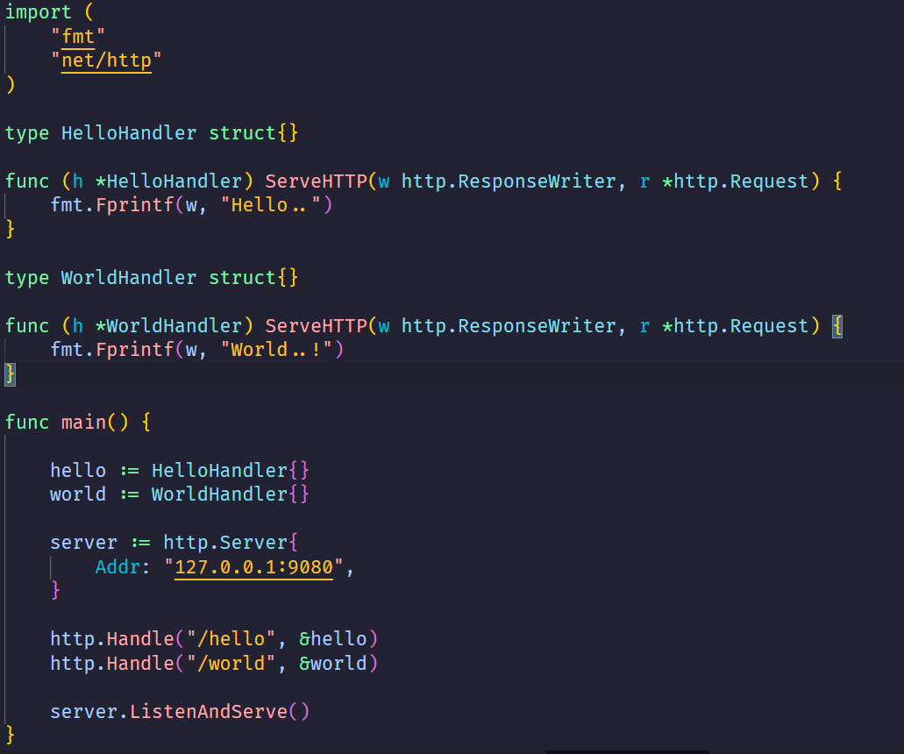
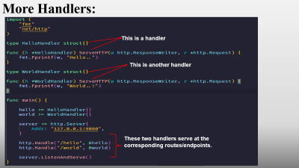
More Handlers:
This is a handler
This is another handler
These two handlers serve at the corresponding routes/endpoints.

Slide 16
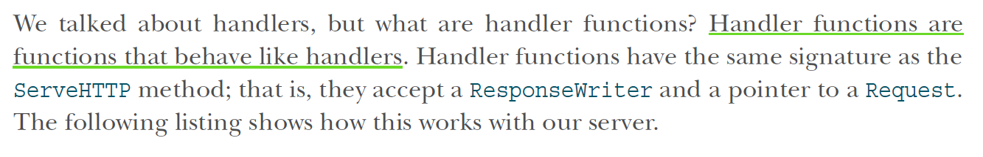
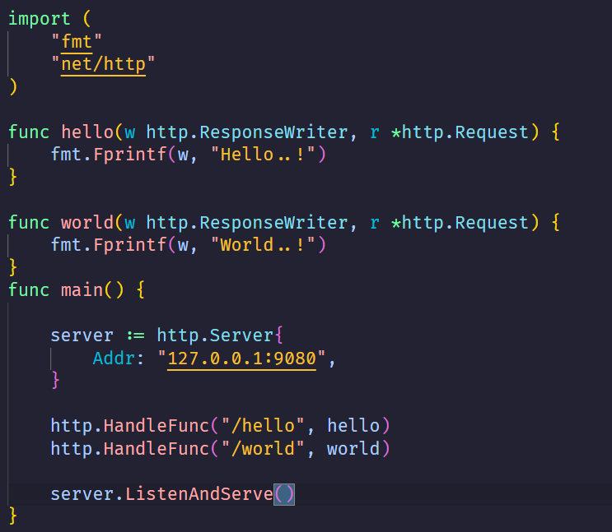
Handler functions:

Slide 17
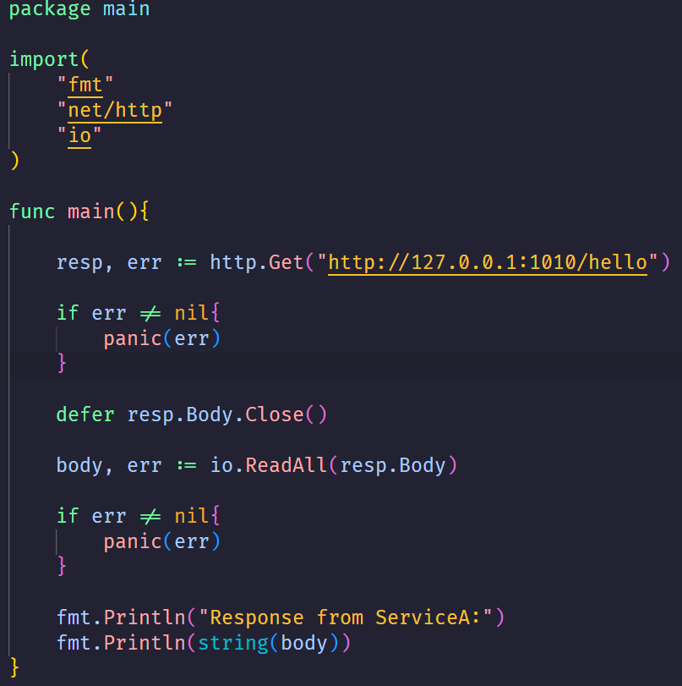
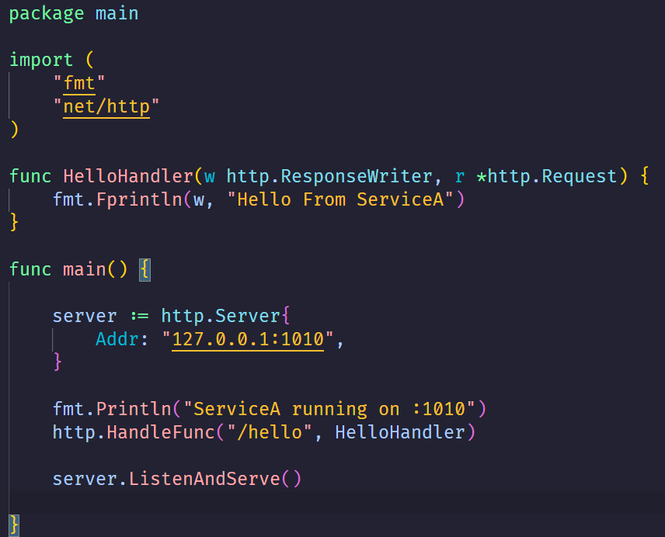
Two Communicating Services:
ServiceA
Caller ServiceB

Slide 18
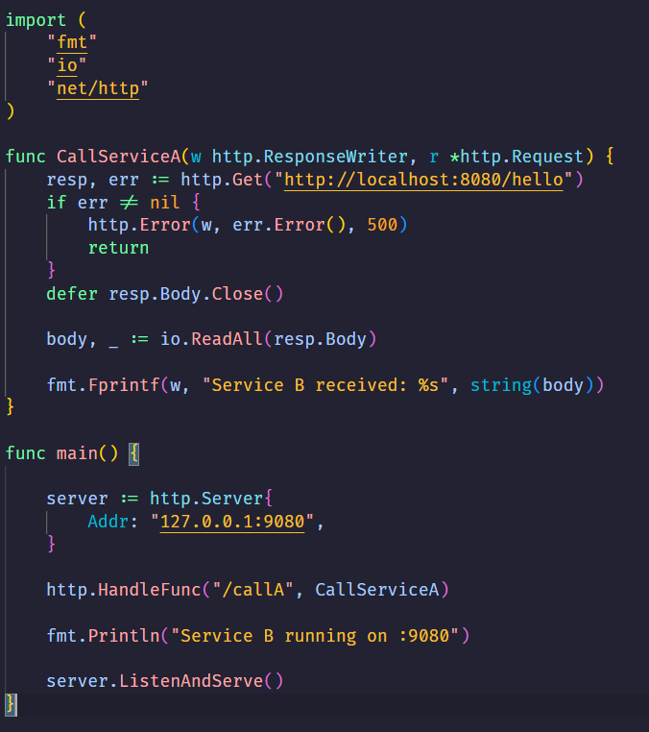
Two Communicating Services by a third service:
Caller ServiceB initiated from other service
ServiceA

Slide 19





Recap & Set:
We have each service listen from somewhere and serve somewhere
Each Service in this design is a whole independent process.
THE WAY TO SET COMMUNICATION AMONG DEVICES IN A CLUSTER AND SYNCHRONIZE THIS COMMUNICATION IS THE CONCEPT OF DISTRIBUTED SYSTEMS/DATABASES
In that sense, if each service does the same thing, then we have done parallelism.
Of course, each process can apply concurrency given a more robust performance.
Now we can extend our scope from just one device to more devices shared in a network creating a cluster
Each device in a cluster holds one or more services and listens to your request.
And in this manner our master is a device that synchronizes all these devices

Slide 20

More On HTTP

Slide 21
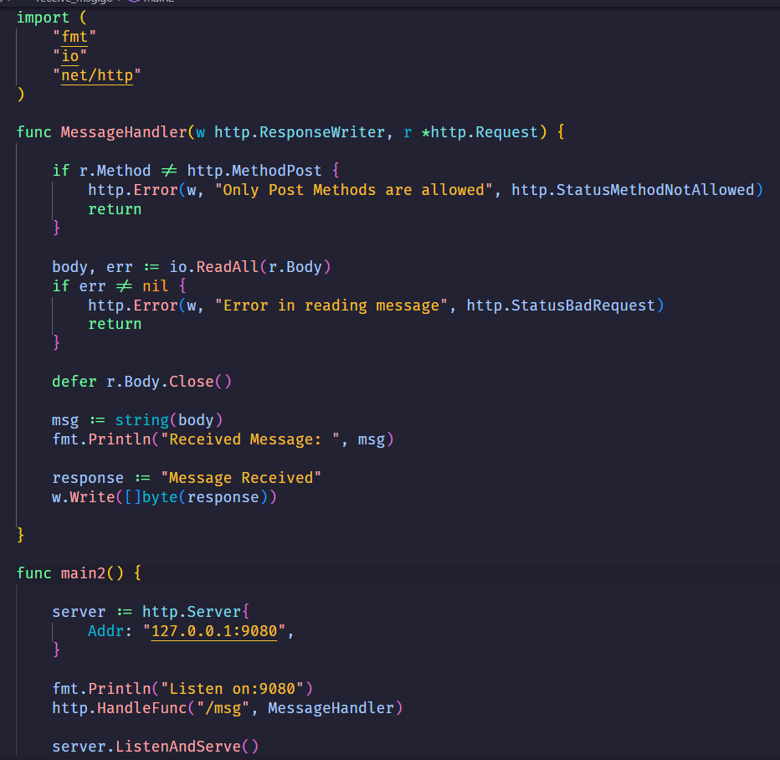
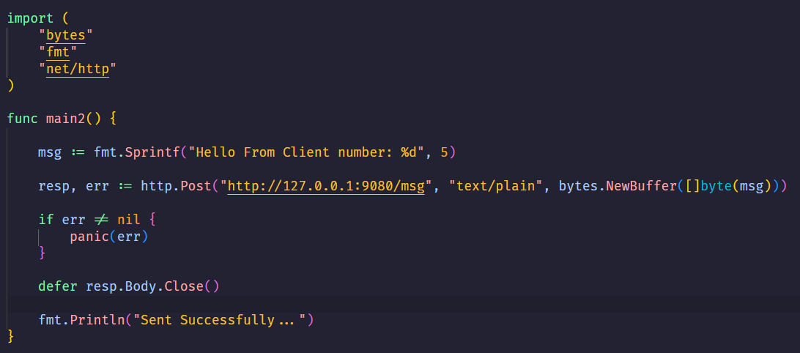
Sending & Receiving Messages
Receiver
Sender

Slide 22
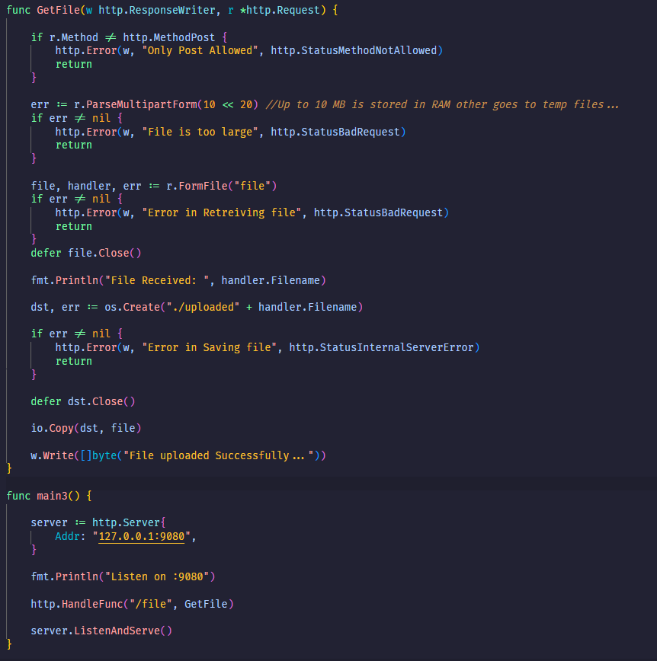
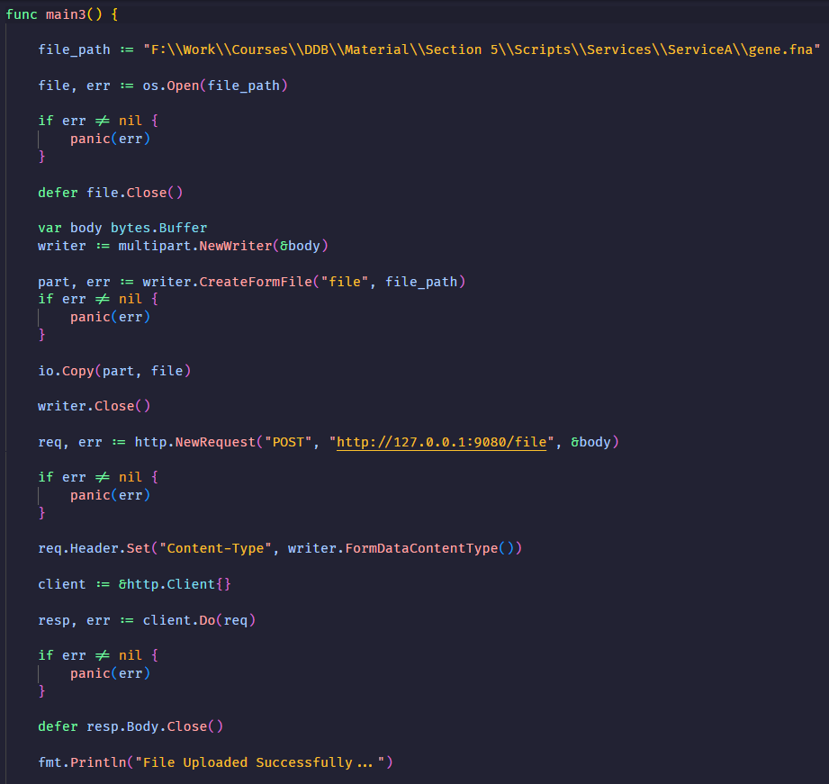
Sending & Receiving Files:
Sender
Receiver

Slide 23
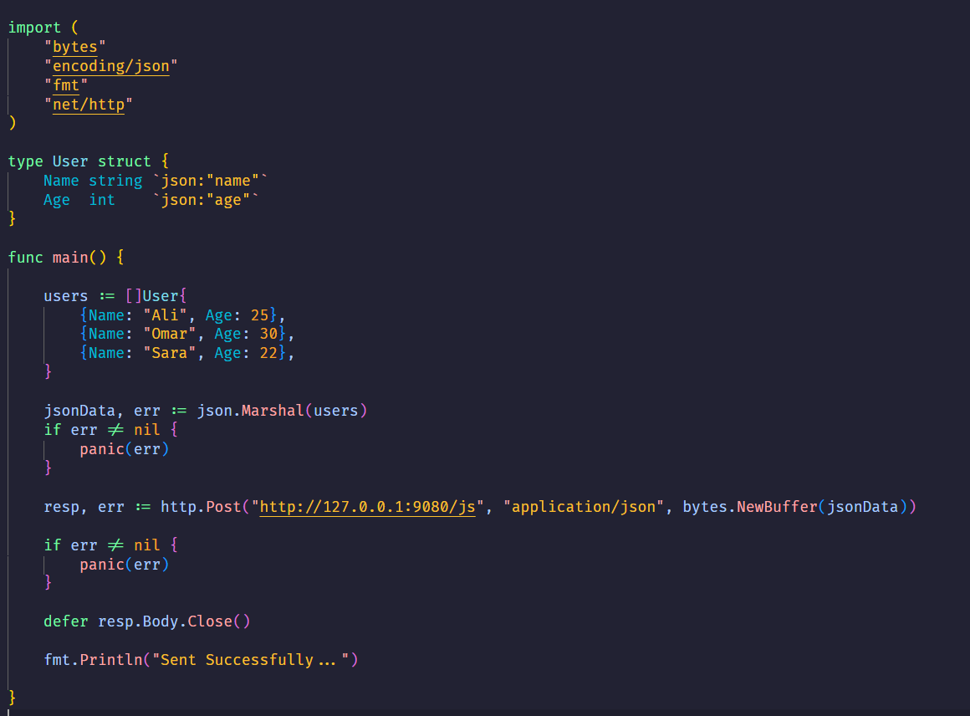
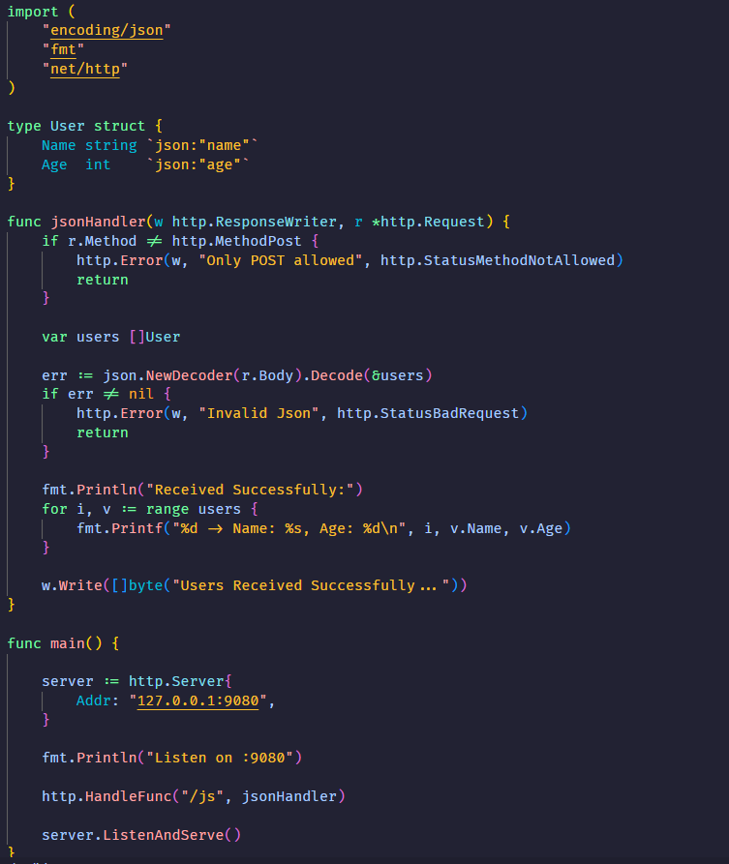
Sending & Receiving Files:
Receiver
Sender

Slide 24
References:
First 3 chapters from the book: Go Web Programming
Recommend to read chapter 1 & 2 from the book: An Introduction to Parallel Programming
Section Records:
https://drive.google.com/drive/folders/1lykzBItpnLUoqoadC1L7yazmz6qPE2zH?usp=sharing

